Slide 1
Finding theory in the code:
Historical Research & Software Archeology
Michael Prietula, PhD, MPH
Goizueta Business School
Emory University
This research was initially funded in part with a grant from the Carnegie-Bosch Institute at the Tepper School of Business at Carnegie Mellon University.

Slide 2
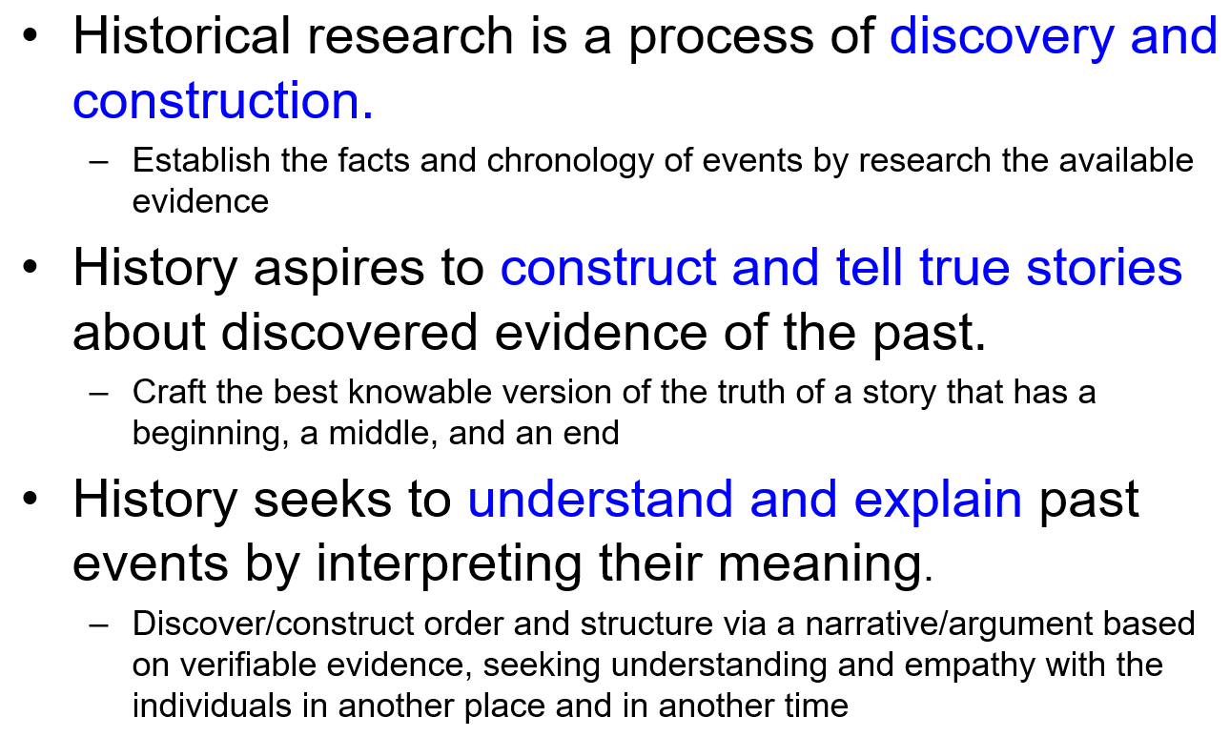

The Nature of Historical Research
Primary Source – document (& quotes), image or artifact that provides us with evidence about the past...including genetic data. [contemporaneous existence]
Secondary Source – book, film, article or museum that displays primary source selectively in order to interpret the past.
Sensitivity to multiple causation
Sensitivity to context
Awareness of the interplay of causality & change

Slide 3
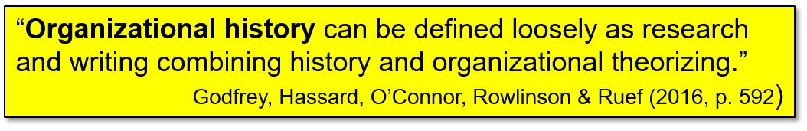
Organizational History
Primary Source – document (& quotes), image or artifact that provides us with evidence about the past...including genetic data. [contemporaneous existence]
Secondary Source – book, film, article or museum that displays primary source selectively in order to interpret the past.

Slide 4
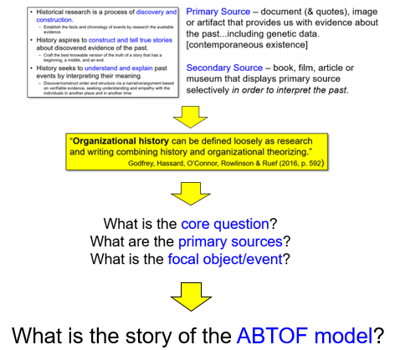
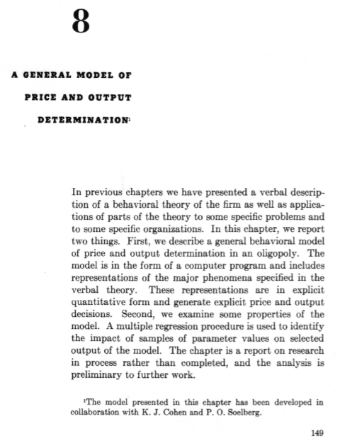

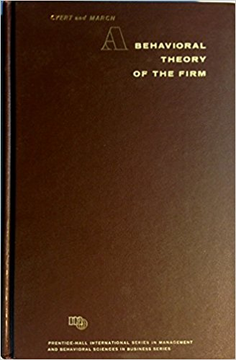
Organizational History

Slide 5
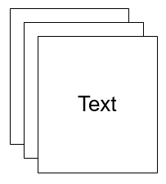
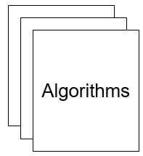
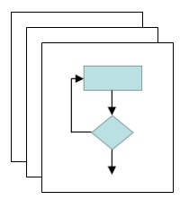
Organizational History

Slide 6
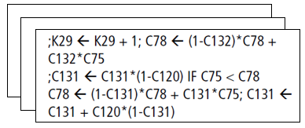
Organizational History

Slide 7
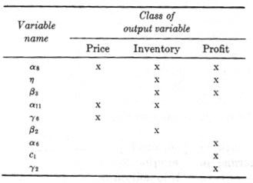
Organizational History
540 Card Images (LoC)
18% of the main text (54 pages)

Slide 8
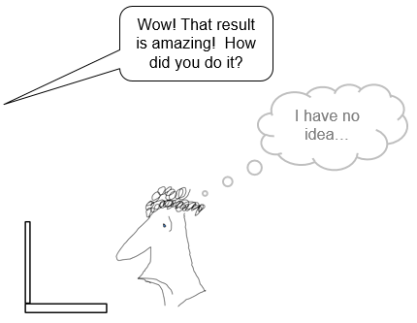
Organizational History
540 Card Images (LoC)
18% of the main text (54 pages)

Slide 9
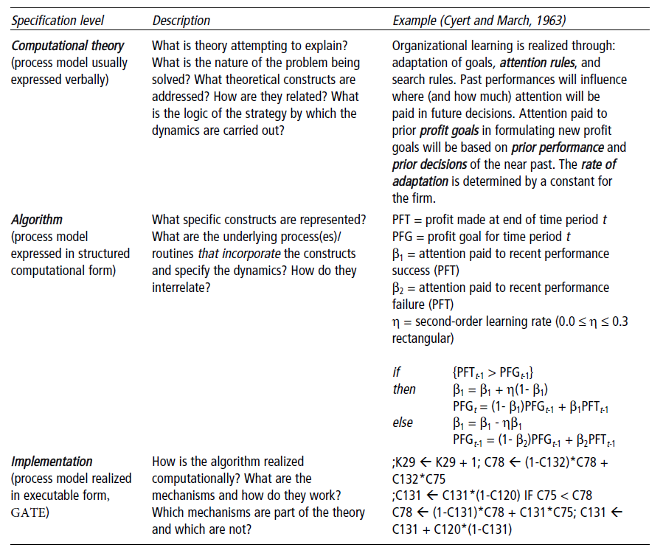
Organizational History
What is asserted
What is implemented

Slide 10
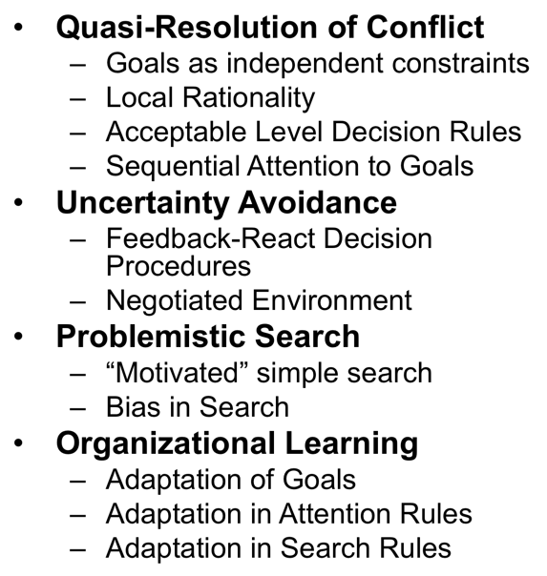
What was in the model?
Theory
Code

Slide 11
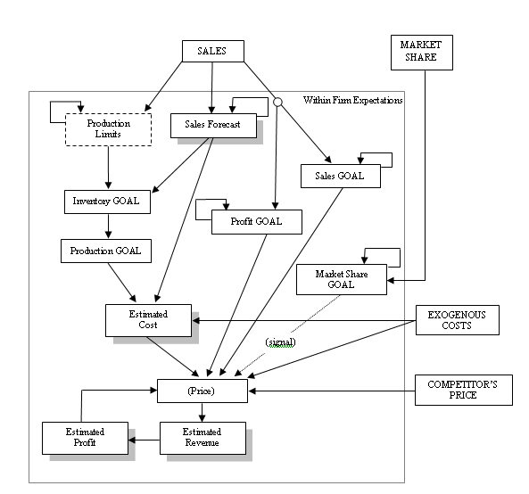
What was in the model?
Quasi-Resolution of Conflict

Slide 12
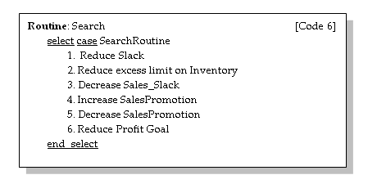
What was in the model?
Problemistic Search

Slide 13
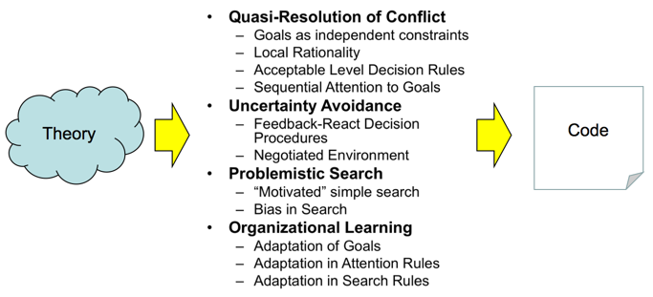
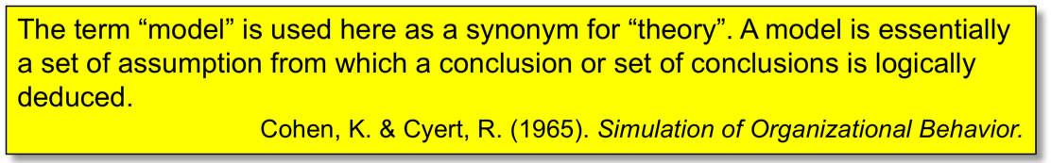
What was in the model?
Analysis

Slide 14
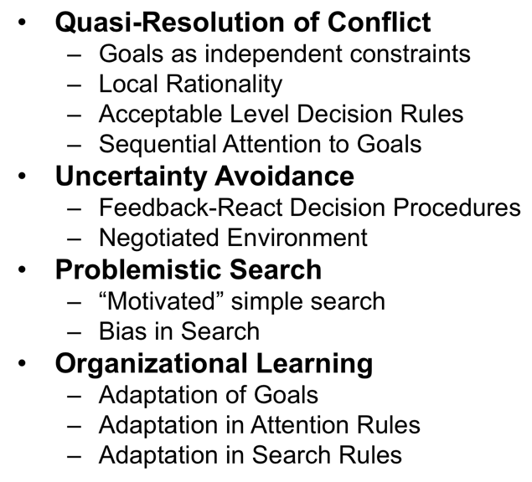
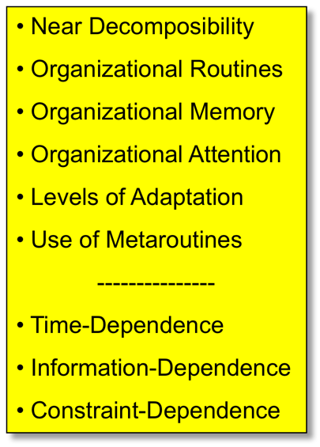
What was in the model?
Additional Constructs
+

Slide 15
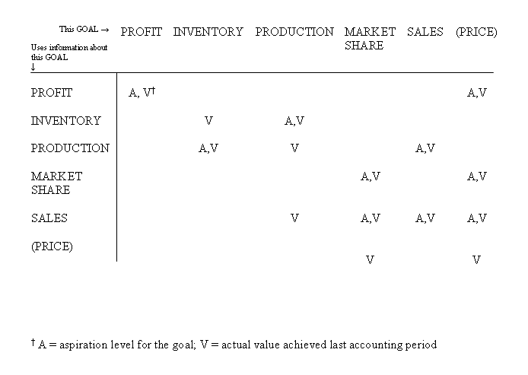
What was in the model?
Near Decomposable

Slide 16
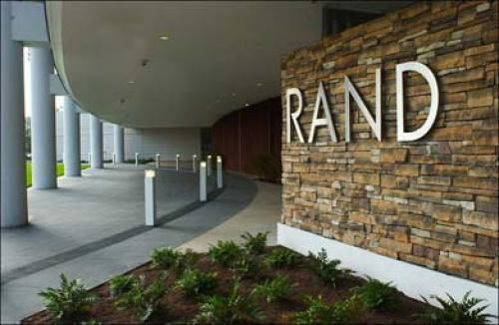

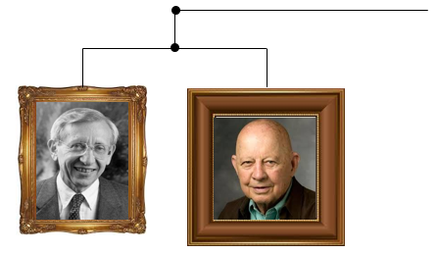


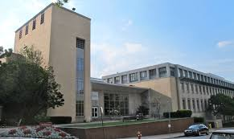
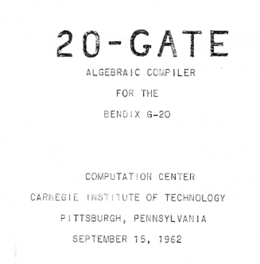
The biography of the model

Slide 17
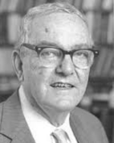
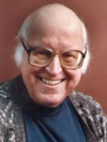
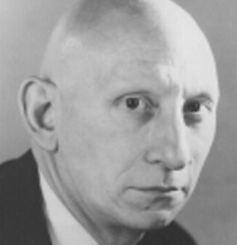

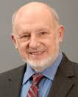

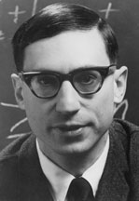
The biography of the model

Slide 18
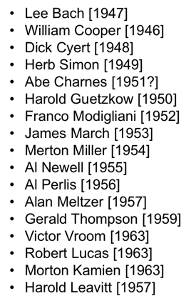
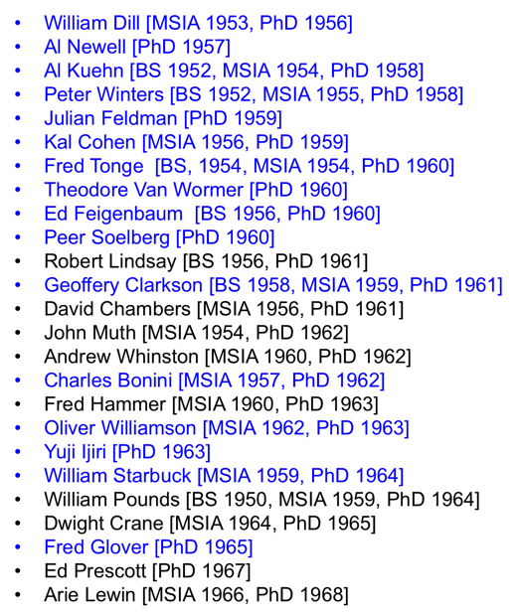
Threads: Who were in the halls?

Slide 19
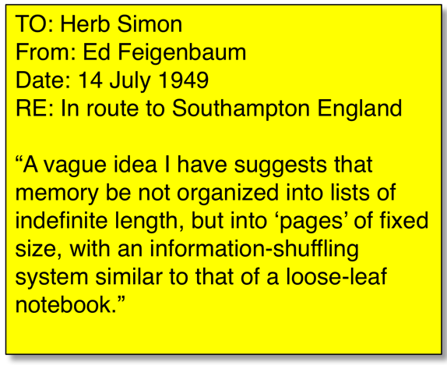
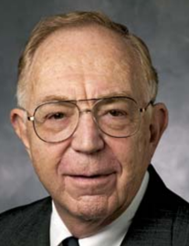
Threads: Who were in the halls?

Slide 20
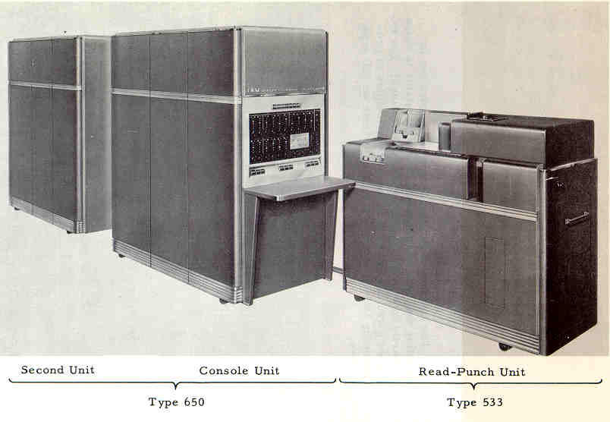
Threads: What was in the basement?

Slide 21
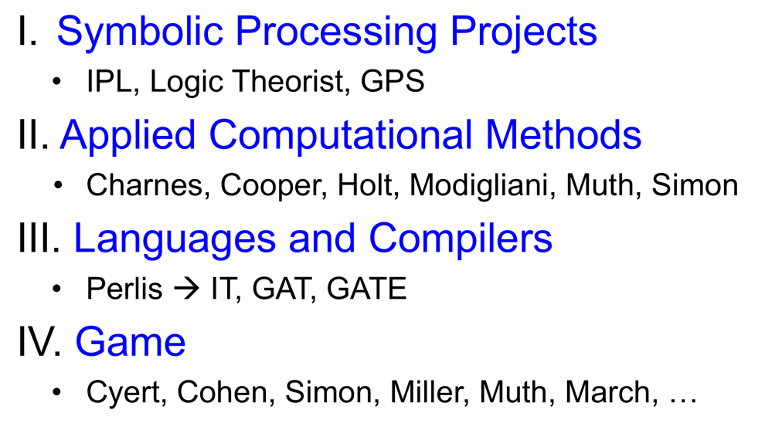
Threads: What was on the machine?

Slide 22
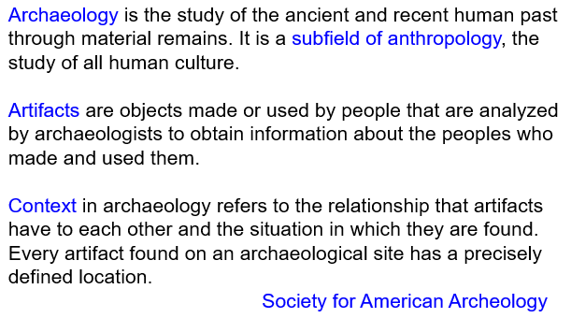
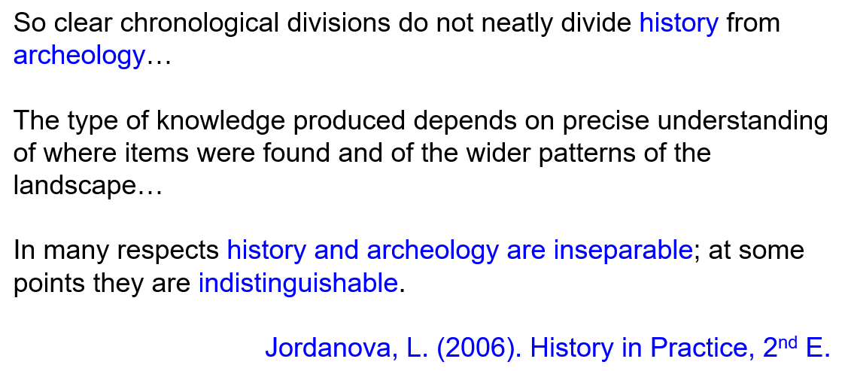
In Conclusion

Slide 23
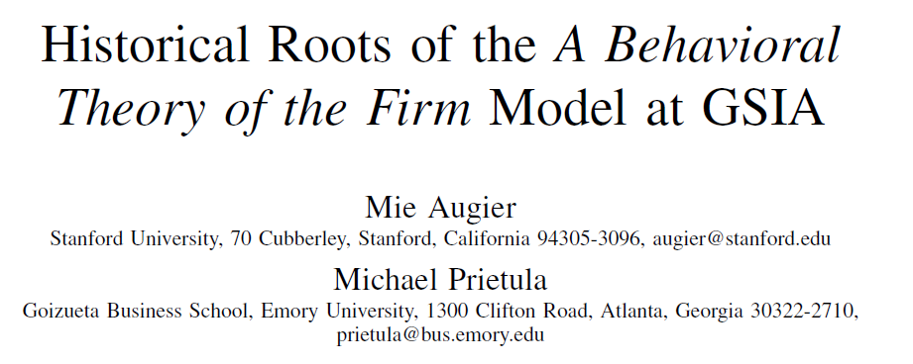
In Conclusion
…that’s in Organization Science…

Slide 24
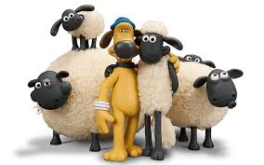
The end

